Slide 1

Machine Learning
Teaching machines how to predict

Slide 2
What is Machine Learning ?
Machine learning is a field of computer science that uses statistical techniques to give computer systems the ability to "learn" with data, without being explicitly programmed.

Slide 3
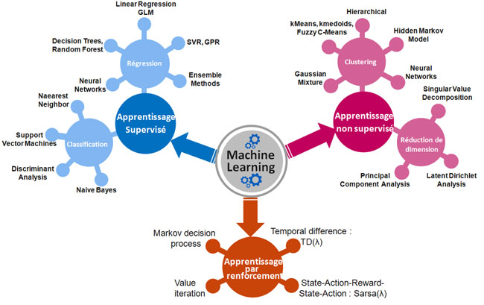
Regression
Clustering
Supervised
Learning
Unsupervised
Learning
Classification
Dimensionality Reduction
Reinforcement learning

Slide 4
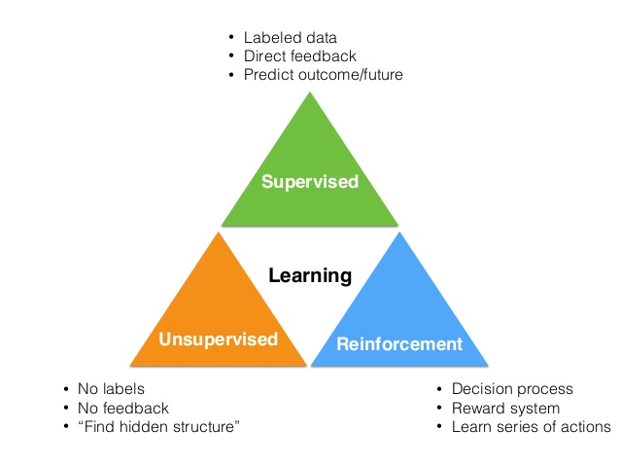
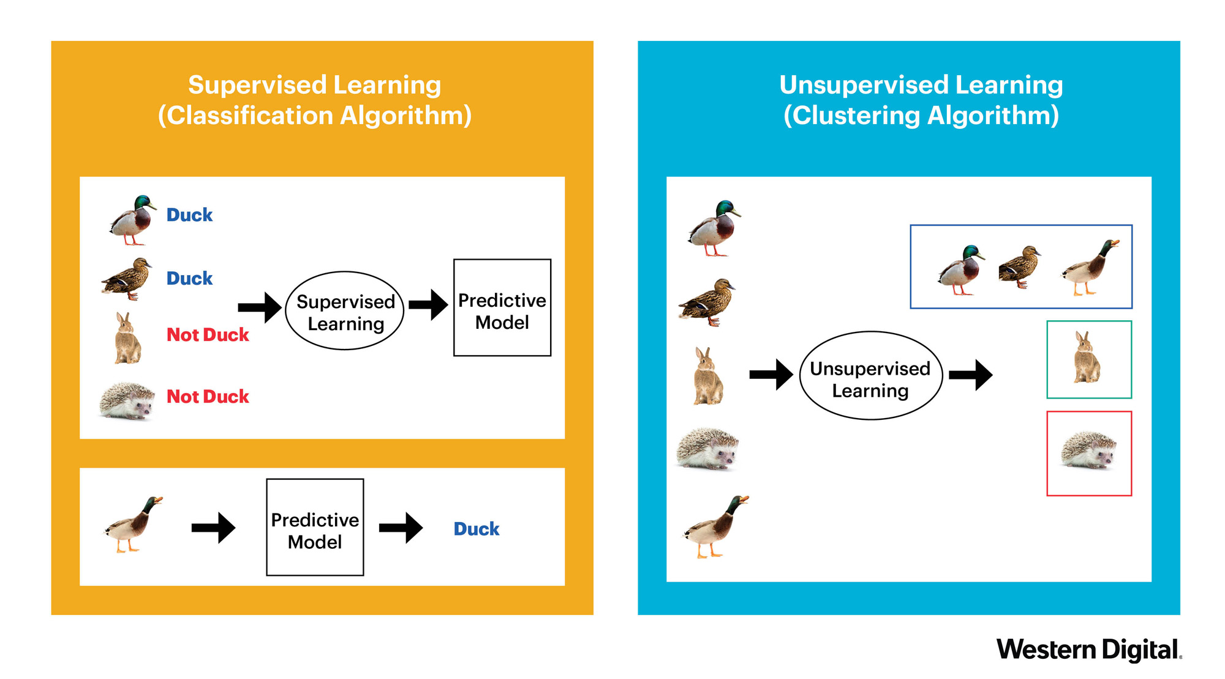
Supervised Learning vs Unsupervised Learning

Slide 5
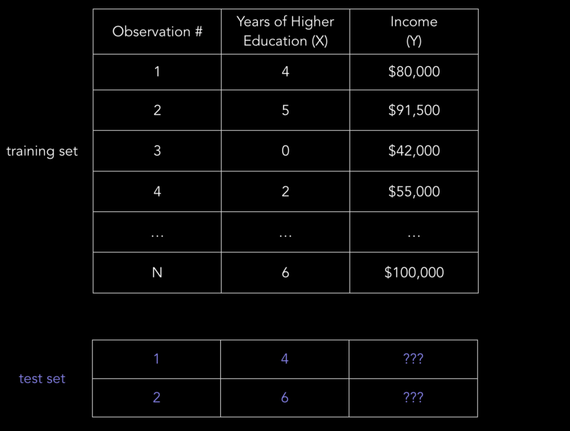
Supervised Learning Example

Slide 6
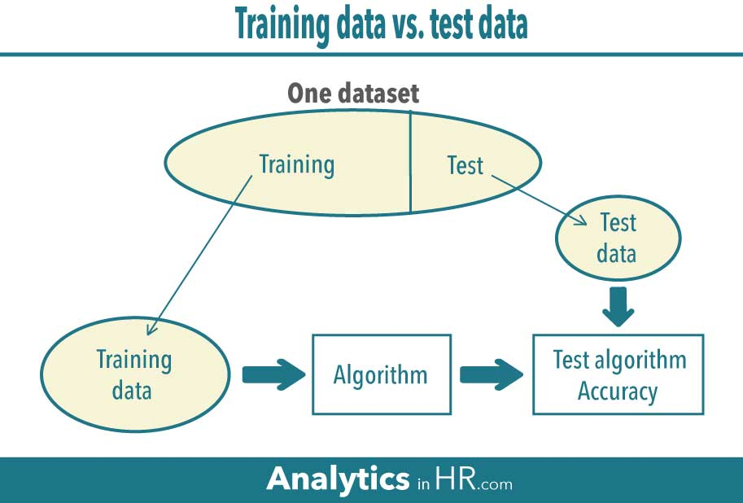

Slide 7
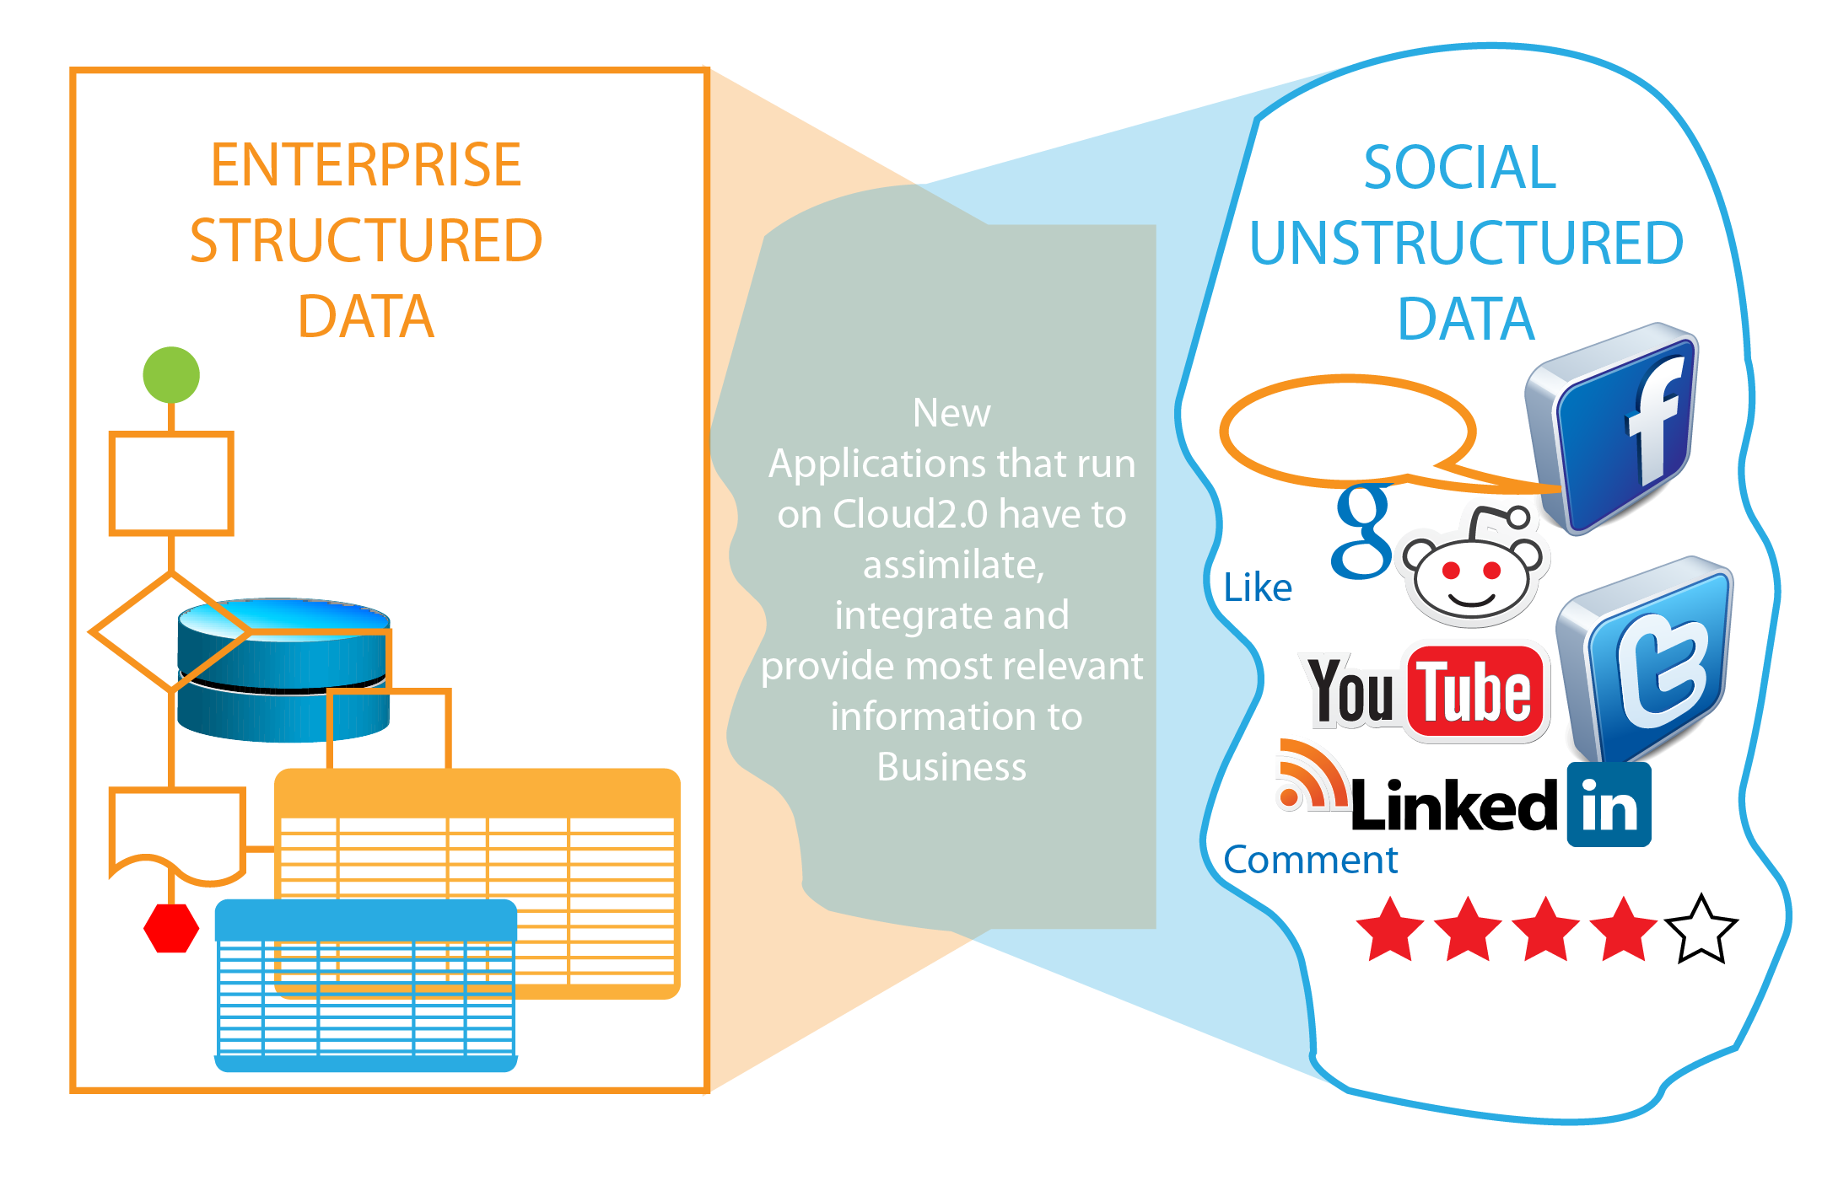
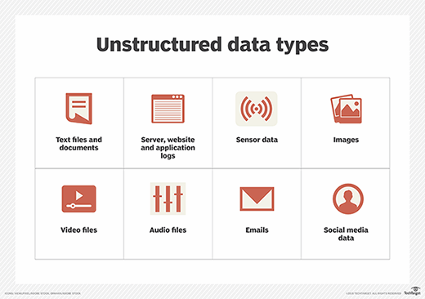
Data

